Slide 1
Transcription of Percussion Instruments in Polyphonic Audio
Final Presentation
Beach Clark, Daniel Ethridge, and Laney Light
12/6/2019

Slide 2
Problem Statement
Transcribe specific percussive sounds in a polyphonic texture
General Approach
Audio signal
Model parameters
Extract features
Select feature set
Run classification model
Ground truth labels
Evaluate model
Notes:
Model= SVM
Model parameters: specify the kernel shape

Slide 3
Data Sources
 | MedleyDB Drums¹ | ENST² | IDMT-SMT³
Tracks | 23 | 143 | 312
Instruments | 6 | 23 | 3
All data sources annotated with instruments at specific times
Instruments common across all 3 datasets: snare drum (SD), hi-hat (HH), kick drum (KD)
Other instruments included in baseline model (MDB only):
cymbal (CY), tom (TT), other (OT)
¹ C. Southall, C.-W. Wu, A. Lerch, and J. Hockman, “MDB Drums -- An Annotated Subset of MedleyDB for Automatic Drum Transcription,” International Society for Music Information Retrieval Conference (ISMIR), At Suzhou, China, 2017.² O. Gillet and G. Richard, “ENST-Drums: an extensive audio-visual database for drum signals processing,” p. 4.
² O. Gillet and G. Richard, “ENST-Drums: an extensive audio-visual database for drum signals processing,” In Proc of ISMIR’06, Victoria, Canada, 2006.
³ C. Dittmar, D. Gartner, “Real-time transcription and separation of drum recordings based on NMF decomposition”, Proceedings of the 17th International Conference on Digital Audio Effects (DAFx-14), Erlangen, Germany, 2014
Notes:
MDB (polyphonic) used for baseline model. Since it is small, we supplemented with ENST, which contains polyphonic and instrument-specific files. Also looked at IDMT which is only monophonic, for comparison with polyphonic results.
Other=side stick or tambourine

Slide 4
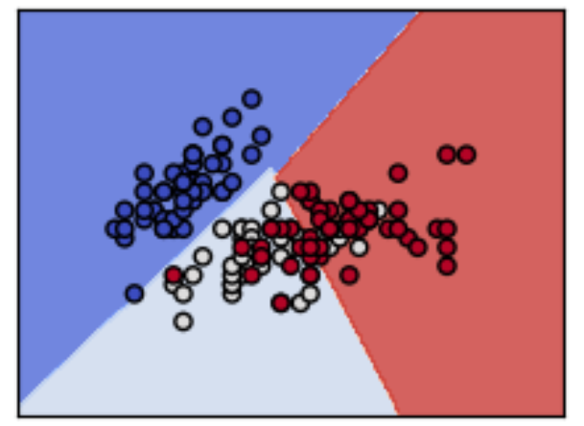
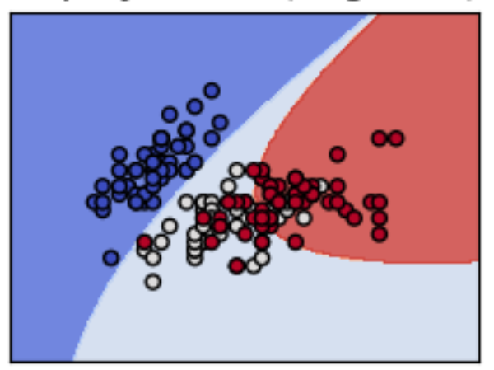
Classification Model
Support Vector Machine (SVM)
Implemented using scikit-learn
Tested several kernel options including linear and polynomial
Linear kernel did not work well
Sigmoid and polynomial provided the best results
Notes:
Plots are from scikit-learn documentation. The kernel specifies the shape of the function used to create the decision boundaries.
Linear kernel predicted everything was a hi hat
For some datasets, sigmoid fit best. For others, polynomial fit best. Tested several others as well.

Slide 5
Features
Calculated each feature for every window
Normalized over all files
Mapped features to annotated labels by time window
10 features in baseline model
First five MFCCs, RMS, spectral flux, spectral crest, zero crossings, and spectral centroid
Additional features in subsequent models
Spectral flatness, spectral rolloff, spectral contrast
RMS with filters (low pass, band pass, high pass)
Differences between filtered RMS features
Feature selection
Logistic regression models (one per instrument)
Identify features with p<.01 for at least one instrument
Distribution plots
Notes:
Because of the size of our data and number of features, it wasn’t feasible to test all possible combinations of features, so we used logistic regression and feature distribution plots to narrow down our list of features to the ones that were important in identifying these percussion instruments
Logistic: also considered other p-value cutoffs and average p-values for each feature across models

Slide 6
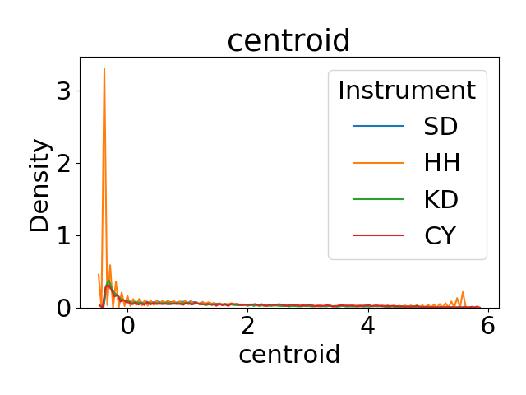
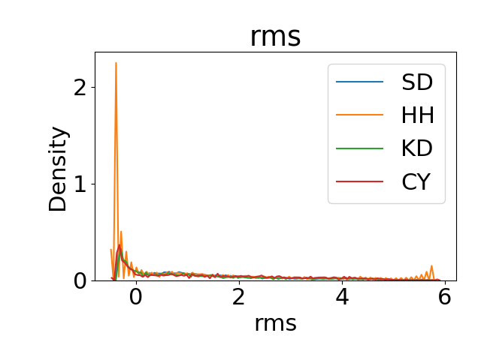
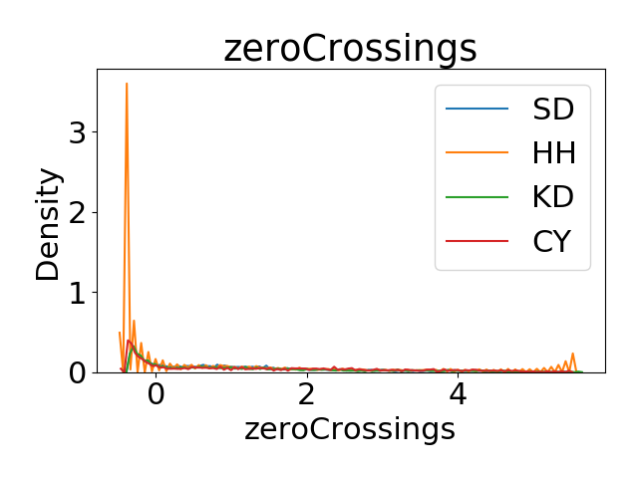
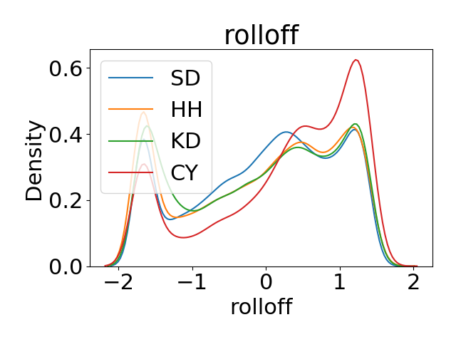
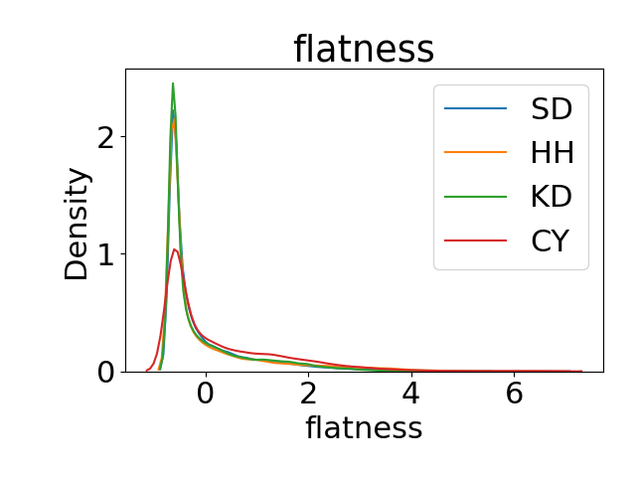
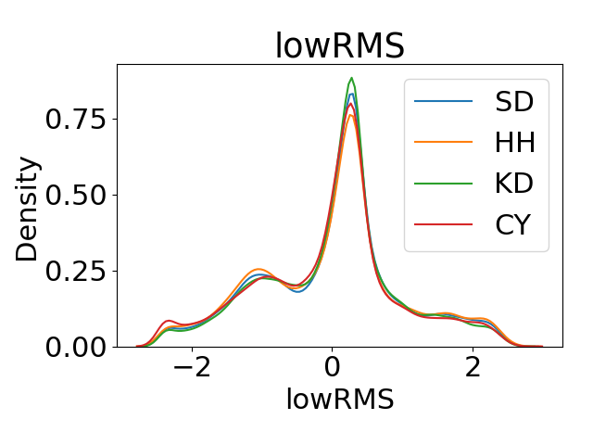
Feature Distribution Plots
Notes:
These are a few examples of the distribution plots we looked at for each feature by instrument. Each of these represents the probability density, where the total area under the curve integrates to one. Our goal here was to see which features appeared to distinguish well between the instruments. There were a few that looked like they might be important in distinguishing hi hat from other instruments (the top row). We saw the biggest difference between the instruments for spectral rolloff.

Slide 7
Feature Sets
Feature | Baseline (10) | Logistic regression (9) | Logistic and/or feature plots (13)
MFCC1 | ✓ | ✓ | ✓
MFCC2 | ✓ | ✓ | ✓
MFCC3 | ✓ | ✓ | ✓
MFCC4 | ✓ | ✓ | ✓
MFCC5 | ✓
RMS | ✓ |  | ✓
Crest | ✓ |  | ✓
Flux | ✓ | ✓ | ✓
Zero crossings | ✓ |  | ✓
Contrast | ✓
Flatness |  | ✓ | ✓
Rolloff |  | ✓ | ✓
RMSF |  | ✓ | ✓
RMS low pass |  | ✓ | ✓
Centroid |  |  | ✓
Notes:
This table shows the features used in each of the feature sets we tested in our models. For the baseline model we used our original set of 10 features. In subsequent models, we tested 2 different feature sets: 9 features identified as strongly associated with at least 1 instrument in the logistic regression models, and the set of 13 features (9 from the logistic models plus another 4 that appeared to distinguish between instruments well in the distribution plots)

Slide 8
Test/Train Splits
MDB only:
75/25 train/test split
Also tested using 10-fold cross validation
ENST only
75/25 train/test split
Combined MDB/ENST
ENST (dry mix and instrument-specific files) as training set
MDB as testing set
IDMT-SMT
75/25 train/test split

Slide 9
Baseline Results*
 | CY | HH | KD | OT | SD | TT
CY | 13 | 32 | 0 | 0 | 16 | 0
HH | 140 | 250 | 0 | 0 | 92 | 2
KD | 76 | 145 | 0 | 0 | 63 | 0
OT | 15 | 9 | 0 | 0 | 1 | 0
SD | 260 | 358 | 0 | 0 | 178 | 6
TT | 10 | 11 | 0 | 0 | 9 | 0
Confusion
Matrix
Instrument | Precision | Recall | F1-score | N observations
HH | 0.03 | 0.21 | 0.05 | 61
SD | 0.31 | 0.52 | 0.39 | 484
KD | 0 | 0 | 0 | 284
CY | 0 | 0 | 0 | 25
TT | 0.5 | 0.22 | 0.31 | 802
OT | 0 | 0 | 0 | 30
Macro Avg | 0.14 | 0.16 | 0.12 | 1686
Weighted Avg | 0.33 | 0.26 | 0.26 | 1686
* MDB Drums data only, 75/25 train/test split, 6 instrument classes, 10 features, sigmoid kernel
Notes:
There was a very small number of toms and other percussion in our annotations (about 1% each). The model did not predict any of these, which was not surprising. However, it also did not predict any kick drums. In our later models, we tried to improve on this by adding more features including RMS filters.

Slide 10
F Scores by Model
Model | F-score
 | MDB only | MDB+ ENST | ESNT only | IDMT only
Baseline: 10 features, 6 instruments, sigmoid kernel | 0.26 | NA | NA | NA
Baseline set of 10 features, 3 instruments, sigmoid | 0.26 | 0.32 | 0.24 | .43
Set of 9 features from logistic regression, sigmoid | 0.37 | 0.28 | 0.31 | .49
Set of 13 features from logistic regression/distribution plots, sigmoid | 0.30 | 0.27 | 0.32 | .55
Set of 13 features from (5), polynomial kernel degree 4 | 0.36 | 0.27 | 0.35 | .81
Notes:
We found that the best feature set depended on the dataset we were using. We didn’t find overwhelming evidence that a certain feature, or combination of features, was best for drum transcription. We suspect this was related to systematic differences in the datasets (how the audio was recorded and how the annotations were done).
F score doesn’t tell the whole story – for example, ENST only with polynomial kernel had highest F-score, but almost never predicted kick drum (sigmoid kernel did better)

Slide 11
Best Fitting Model Predicting MDB Drums
 | HH | KD | SD
HH | 40 | 40 | 53
KD | 23 | 9 | 29
SD | 76 | 38 | 92
Confusion
Matrix
Instrument | Precision | Recall | F1-score
HH | 0.29 | 0.30 | 0.29
KD | 0.10 | 0.15 | 0.12
SD | 0.53 | 0.45 | 0.48
Macro Avg | 0.31 | 0.30 | 0.3
Weighted Avg | 0.38 | 0.35 | 0.37
*trained on MDB data only, 3 instrument classes, 9 features from logistic regression, sigmoid
Notes:
When we limited it to only the 3 most common instruments and also use feature set from the logistic regression, we see some improvements in the kick drum prediction (there were 0 predicted in the baseline model), but our model still has the hardest time identifying KD compared to other instruments. Our hi hat predictions improved a lot over the baseline model, but the confusion matrix shows it still gets confused with snare often.

Slide 12
Conclusions
Model works well when the drum sounds are separated out
Predictions are worse for polyphonic audio
Kick drum prediction was problematic
Feature selection and kernel type have a significant impact on model performance
Best feature set and kernel type depended on the data source

